Slide 1



chapter 5
interaction design basics

Slide 2
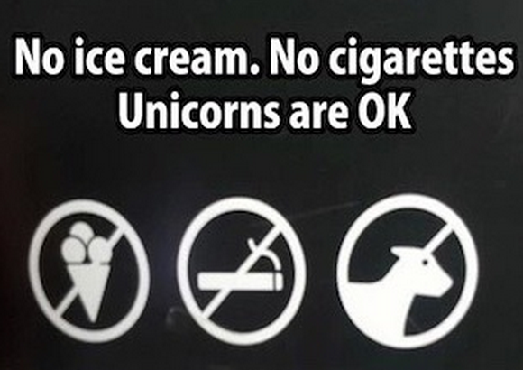

Slide 3
interaction design basics
design:
      what it is, interventions, goals, constraints, trade-offs
the design process
      what happens when
users
      who they are, what they are like …
scenarios
      rich stories of design
navigation
      finding your way around a system
iteration and prototypes
      never get it right first time!

Slide 4
The temptation is to focus on one or other goal and optimize for this, then tweak the design to make it just satisfy the constraints and other goals.

Slide 5
interactions and interventions
design interactions not just interfaces
  not just the immediate interaction
  e.g. stapler in office – technology changes interaction style
    manual: write, print, staple, write, print, staple, …
    electric: write, print, write, print, …, staple
designing interventions not just artefacts
  not just the system, but also …
    documentation, manuals, tutorials
    what we say and do as well as what we make

Slide 6
what is design?

Slide 7
what is design?
achieving goals within constraints
goals - purpose
  who is it for, why do they want it
constraints
  materials, platforms
trade-offs: Eye tracking without specialized device

Slide 8
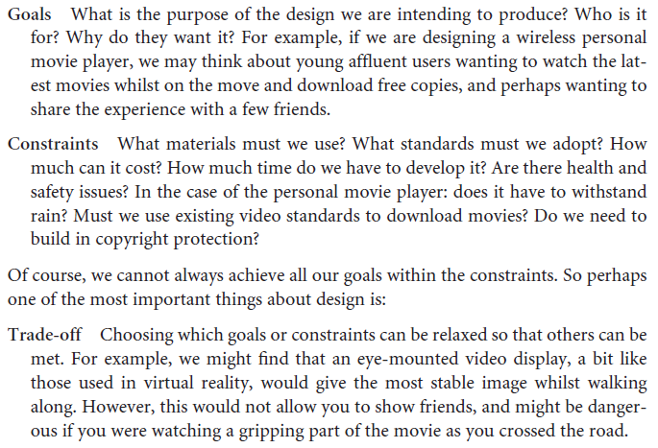


Slide 9
golden rule of design
understand your materials

Slide 10
for Human–Computer Interaction
understand your materials
understand computers
  limitations, capacities, tools, platforms
understand people
  psychological, social aspects
  human error
and their interaction …

Slide 11
To err is human
accident reports ..
  aircrash, industrial accident, hospital mistake
  enquiry … blames … ‘human error’
but …
  concrete lintel breaks because too much weight
  blame ‘lintel error’ ?
  … no – design error
  we know how concrete behaves under stress
human ‘error’ is normal
  we know how users behave under stress
  so design for it!
treat the user at least as well as physical materials!

Slide 12
Central message …
the user

Slide 13
The process of design
scenarios
task analysis
what is
wanted
guidelines
principles
analysis
interviews
ethnography
what is there
vs.
what is wanted
precise
specification
design
dialogue
notations
implement
and deploy
evaluation
heuristics
prototype
architectures
documentation
help

Slide 14
Steps …
requirements
  what is there and what is wanted …
analysis
  ordering and understanding
design
  what to do and how to decide
iteration and prototyping
  getting it right … and finding what is really needed!
implementation and deployment
  making it and getting it out there

Slide 15
… but how can I do it all ! !
limited time ⇒ design trade-off
usability?
  finding problems and fixing them?
  deciding what to fix?
a perfect system is badly designed
  too good ⇒ too much effort in design



Slide 17
user focus
know your user
personae
cultural probes

Slide 18
know your user
who are they?
probably not like you!
talk to them
watch them: When black-belt judo players are asked how they throw an opponent, their explanations do not match what they actually do.
use your imagination

Slide 19
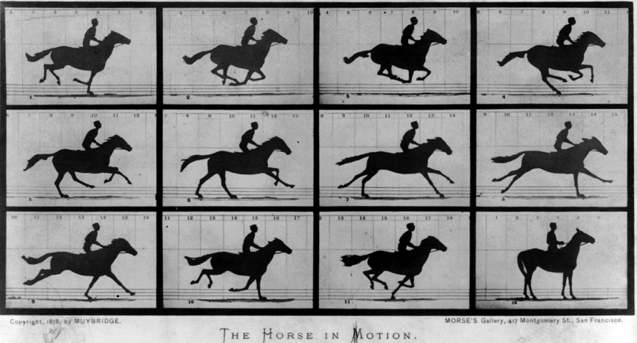
Eadweard Muybridge

Slide 20
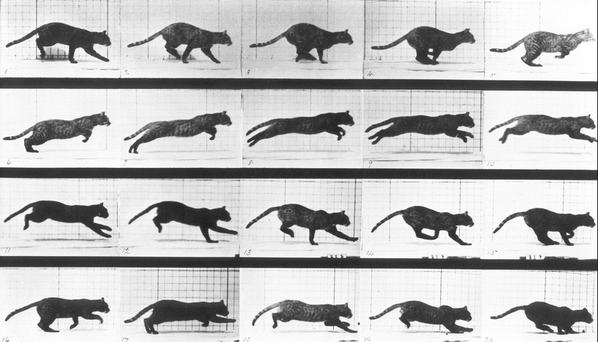

Slide 21
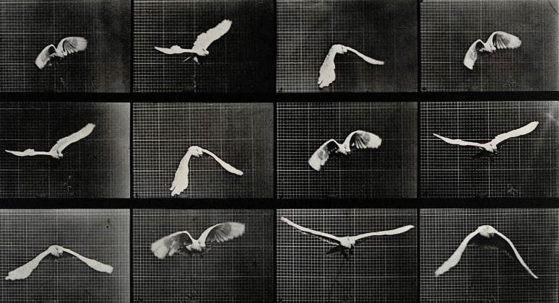

Slide 22
Watch them at work.
Record them at work.
Set reminders 15, 30 mins apart and ask them to write down what they have done since the last reminder.

Slide 23

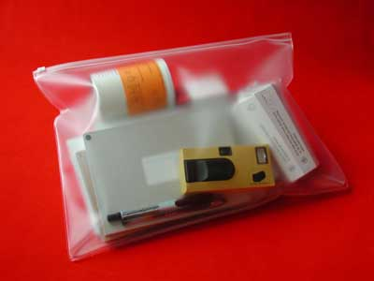
cultural probes
direct observation
  sometimes hard
    in the home
    psychiatric patients, …
probe packs
  items to prompt responses
    e.g. glass to listen at wall, camera, postcard
  given to people to open in their own environment
  they record what is meaningful to them
used to …
  inform interviews, prompt ideas, enculture designers

Slide 24
persona
A persona is a rich picture of an imaginary person who represents your core user group.
use as surrogate user
  what would Betty think
details matter
  makes her ‘real’

Slide 25
example persona
Betty is 37 years old, She has been Warehouse Manager for five years and worked for Simpkins Brothers Engineering for twelve years. She didn’t go to university, but has studied in her evenings for a business diploma. She has two children aged 15 and 7 and does not like to work late. She did part of an introductory in-house computer course some years ago, but it was interrupted when she was promoted and could no longer afford to take the time. Her vision is perfect, but her right-hand movement is slightly restricted following an industrial accident 3 years ago. She is enthusiastic about her work and is happy to delegate responsibility and take suggestions from her staff. However, she does feel threatened by the introduction of yet another new computer system (the third in her time at SBE).

Slide 26
scenarios
stories for design
use and reuse

Slide 27
scenarios
stories for design
  communicate with others
  validate other models
  understand dynamics
the user intends to press the “save” button, but accidentally presses the “quit” button so loses his work’.
Or just describe the situation or context
linearity
  time is linear - our lives are linear
  but don’t show alternatives

Slide 28
scenarios …
what will users want to do?
step-by-step walkthrough
  what can they see (sketches, screen shots)
  what do they do (keyboard, mouse etc.)
  what are they thinking?
use and reuse throughout design

Slide 29
scenario – movie player
Brian would like to see the new film “Moments of Significance” and wants to invite Alison, but he knows she doesn’t like “arty” films. He decides to take a look at it to see if she would like it and so connects to one of the movie sharing networks. He uses his work machine as it has a higher bandwidth connection, but feels a bit guilty. He knows he will be getting an illegal copy of the film, but decides it is OK as he is intending to go to the cinema to watch it. After it downloads to his machine he takes out his new personal movie player. He presses the ‘menu’ button and on the small LCD screen he scrolls using the arrow keys to ‘bluetooth connect’ and presses the select button. On his computer the movie download program now has an icon showing that it has recognised a compatible device and he drags the icon of the film over the icon for the player. On the player the LCD screen says “downloading now”, a percent done indicator and small whirling icon. … … …

Slide 30
Storyboard
Next slide

Slide 31
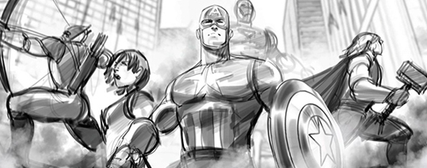
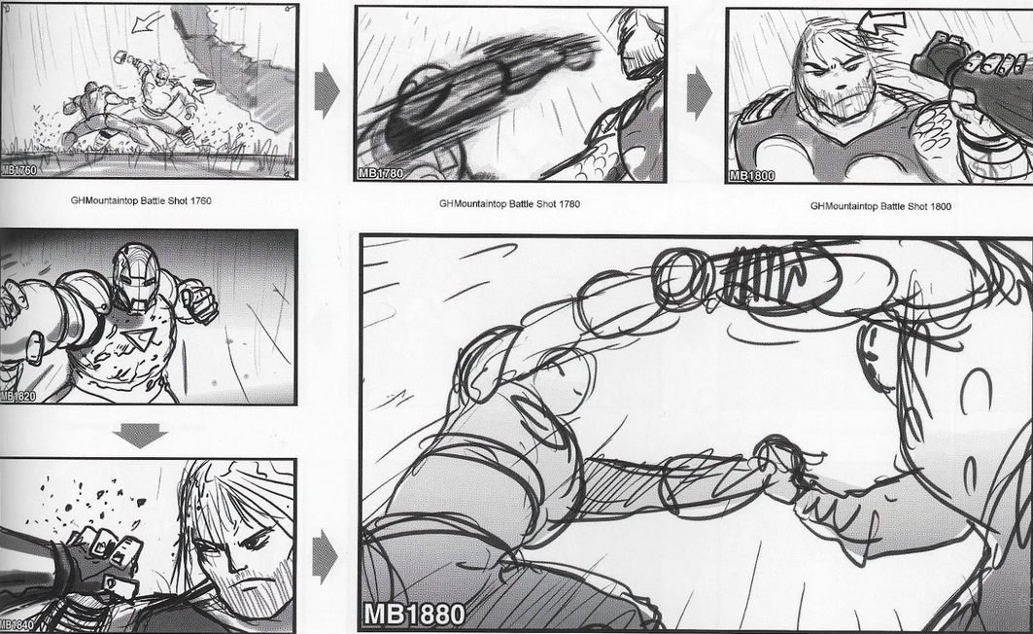

Slide 32
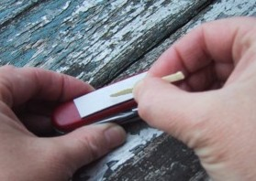
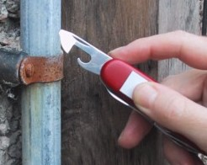
also play act …
mock up device
pretend you are doing it
internet-connected swiss army knife …
but where is that thumb?
use toothpick as stylus

Slide 33
… explore the depths
explore interaction
  what happens when
explore cognition
  what are the users thinking
explore architecture
  what is happening inside

Slide 34
use scenarios to ..
communicate with others
  designers, clients, users
validate other models
  ‘play’ it against other models
express dynamics
  screenshots – appearance
  scenario – behaviour

Slide 35
linearity
Scenarios – one linear path through system
Pros:
  life and time are linear
  easy to understand (stories and narrative are natural)
  concrete (errors less likely)
Cons:
  no choice, no branches, no special conditions
  miss the unintended
So:
  use several scenarios
  use several methods

Slide 37
navigation design
the systems
info and help
management
messages
start
add user
remove user
local structure – single screen
global structure – whole site
main
screen
remove
user
confirm
add user

Slide 38
levels
widget choice
  menus, buttons etc.
screen design
application navigation design
environment
  other apps, O/S

Slide 39
Widgets The appropriate choice of widgets and wording in menus and buttons will help you know how to use them for a particular selection or action.
Screens or windows You need to find things on the screen, understand the logical grouping of buttons.
Navigation within the application You need to be able to understand what will happen when a button is pressed, to understand where you are in the interaction.
Environment The word processor has to read documents from disk, perhaps some are on remote networks. You swap between applications, perhaps cut and paste.

Slide 40
the web …
widget choice
screen design
navigation design
environment
elements and tags
  <a href=“...”>
page design
site structure
the web, browser,
external links

Slide 41
physical devices
widget choice
screen design
navigation design
environment
controls
  buttons, knobs, dials
physical layout
modes of device
the real world

Slide 42
The place to start when considering the structure of an application is to think about actual use:
  who is going to use the application?
  how do they think about it?
  what will they do with it?
This will help us understand and decide the structure of the application

Slide 43
think about structure
within a screen
local
  looking from this screen out
global
  structure of site, movement between screens
wider still
  relationship with other applications

Slide 44
local
from one screen looking out, what next?
Goals and goal seeking

Slide 45
goal seeking
goal
start

Slide 46
goal seeking
goal
start
progress with local (partial) knowledge only ...

Slide 47
goal seeking
goal
start
… but can get to the goal

Slide 48
goal seeking
goal
start
… try to avoid these bits!

Slide 49
four golden rules
knowing where you are (synthesizability?)
knowing what you can do (visibility?)
knowing where you are going (predictability?)
  or what will happen (Modes?)
knowing where you’ve been (synthesizability/ feedback?)
  or what you’ve done

Slide 50
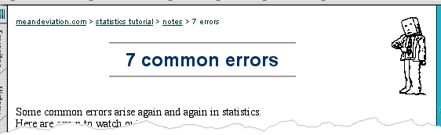
where you are – breadcrumbs
shows path through web site hierarchy
top level category
sub-category
web site
this page
live links
to higher
levels

Slide 51
beware the big button trap
things
other things
more things
the thing from
outer space
where do they go?
  lots of room for extra text!

Slide 52
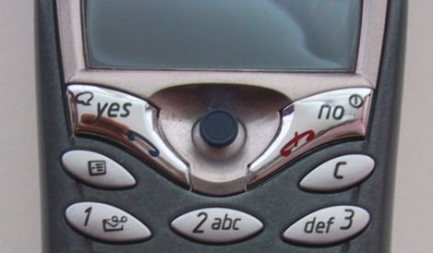
modes
lock to prevent accidental use …
  remove lock - ‘c’ + ‘yes’ to confirm
  frequent practiced action
if lock forgotten
  in pocket ‘yes’ gets pressed
  goes to phone book
  in phone book …
  ‘c’ – delete entry
  ‘yes’ – confirm
  … oops !

Slide 53
global
between screens
within the application

Slide 54
The way the various screens, pages or device states link to one another.
One way to organize a system is in some form of hierarchy. This is typically organized along functional boundaries (that is, different kinds of things), but may be organized by roles, user type, or some more esoteric breakdown such as modules in an educational system.
Esoteric: intended for or likely to be understood by only a small number of people with a specialized knowledge or interest.

Slide 55
Use hierarchical diagrams
the system
info and help
management
messages
add user
remove user

Slide 56
hierarchical diagrams ctd.
parts of application
  screens or groups of screens
typically functional separation
no good creating a hierarchy that the designers understand, but not the users
the systems
info and help
management
messages
add user
remove user

Slide 57
navigating hierarchies
deep is difficult!
misuse of Miller’s 7 ± 2
  short term memory, not menu size
  May apply if breadcrumbs are not used.
optimal?
  many items on each screen
  but structured within screen
see /e3/online/menu-breadth/

Slide 58
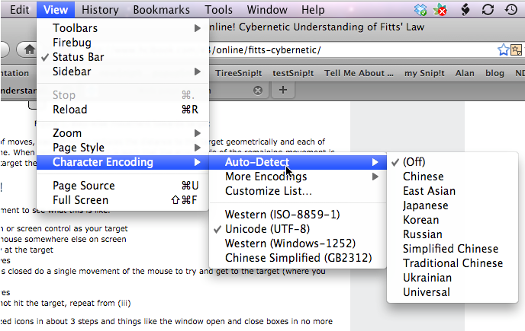

Slide 59
network diagrams (dialog)
main
screen
remove
user
confirm
add user
show different paths through system

Slide 60
network diagrams ctd.
what leads to what
what happens when
including branches
more task oriented than hierarchy
main
screen
remove
user
confirm
add user

Slide 61
wider still
between applications
and beyond ...

Slide 62
wider still …
style issues:
  Conform to platform standards, consistency
functional issues
  Read standard formats, Should have cut and paste feature, etc
navigation issues
  links to other apps … the web
  Clicking on mail should open mail client
  Drag drop attachment

Slide 64
screen design and layout
✓
Dix , Alan
Finlay, Janet
Abowd, Gregory
Beale, Russell
basic principles
grouping, structure, order
alignment
use of white space
ABCDEFHIJKLM
NOPQRSTUVWXYZ

Slide 65
basic principles
ask
  what is the user doing?
think
  what information, comparisons, in what order
design
  form follows function

Slide 66
available tools
grouping of items
order of items
decoration - fonts, boxes etc.
alignment of items
white space between items

Slide 67
grouping and structure
logically together ⇒ physically together
Billing details:
Name
Address: …
Credit card no
Delivery details:
Name
Address: …
Delivery time
Order details:
item quantity cost/item cost
size 10 screws (boxes) 7 3.71 25.97
…… … … …

Slide 68
order of groups and items
think! - what is natural order
should match screen order!
  use boxes, space etc.
  set up tabbing right!
instructions
  beware the cake recipie syndrome!
  … mix milk and flour, add the fruit
  after beating them

Slide 69
decoration
use boxes to group logical items
use fonts for emphasis, headings
but not too many!!
ABCDEFHIJKLM
NOPQRSTUVWXYZ

Slide 70
alignment - text
you read from left to right (English and European)
⇒ align left hand side
boring but
readable!
Willy Wonka and the Chocolate Factory
Winston Churchill - A Biography
Wizard of Oz
Xena - Warrior Princess
Willy Wonka and the Chocolate Factory
Winston Churchill - A Biography
Wizard of Oz
Xena - Warrior Princess
fine for special effects but hard to scan

Slide 71
alignment - names
Usually scanning for surnames ⇒ make it easy!
✗
✓
Alan Dix
Janet Finlay
Gregory Abowd
Russell Beale
Dix , Alan
Finlay, Janet
Abowd, Gregory
Beale, Russell
✓
Alan Dix
Janet Finlay
Gregory Abowd
Russell Beale

Slide 72

alignment - numbers
think purpose!
which is biggest?
532.56
179.3
256.317
15
73.948
1035
3.142
497.6256

Slide 73
alignment - numbers
visually:
long number = big number
align decimal points
or right align integers
627.865
1.005763
382.583
2502.56
432.935
2.0175
652.87
56.34

Slide 74
multiple columns
scanning across gaps hard:
(often hard to avoid with large data base fields)
sherbert 75
toffee 120
chocolate 35
fruit gums 27
coconut dreams 85

Slide 75
multiple columns - 2
use leaders
sherbert 75
toffee 120
chocolate 35
fruit gums 27
coconut dreams 85

Slide 76
multiple columns - 3
or greying (vertical too)
sherbert 75
toffee 120
chocolate 35
fruit gums 27
coconut dreams 85

Slide 77
multiple columns - 4
or even (with care!) ‘bad’ alignment
sherbert 75
toffee 120
chocolate 35
fruit gums 27
coconut dreams 85

Slide 78
White space (aka negative space) white space - the counter
WHAT YOU SEE

Slide 79
white space - the counter
It is the space which is left untouched in order to make the page more readable and easy-to-interpret.
WHAT YOU SEE
THE GAPS BETWEEN

Slide 80
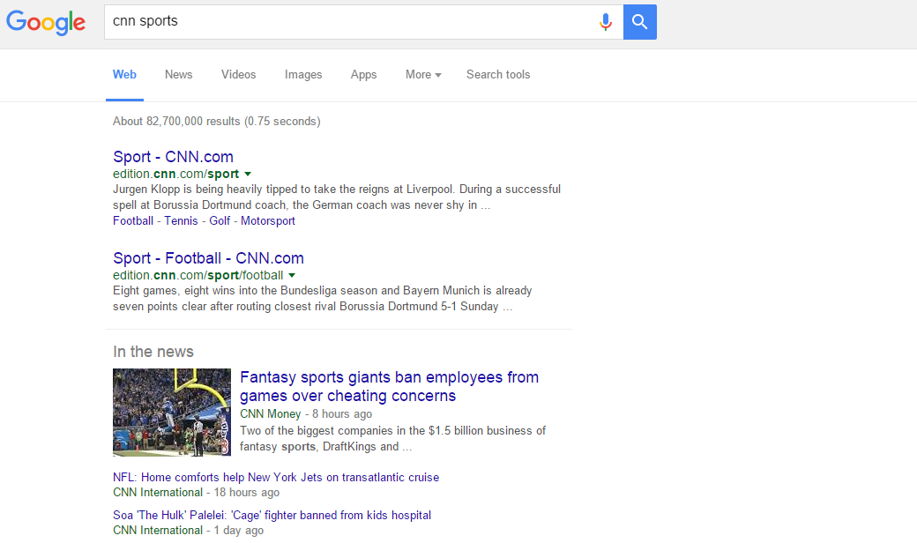

Slide 81
space to separate
“White space is to be regarded as an active element, not a passive background,” wrote Jan Tschichold in 1930.

Slide 82
space to structure

Slide 83
space to highlight

Slide 84
Highlight the Call To Actions(CTAs):
An increased level of comprehension: Capable of increasing the comprehension by around 20%
Keeping the site tidy is possible with white spaces: White spaces can easily add a sense of elegance and individuality to your site.
White spaces make designs more pleasant to look at: NEXT SLIDE

Slide 85
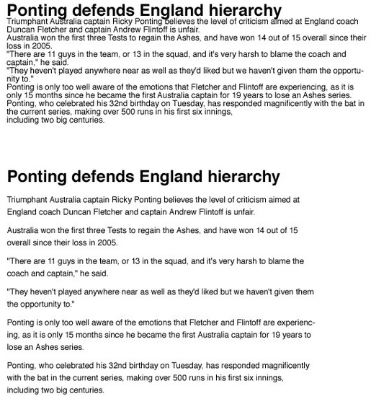

Slide 86
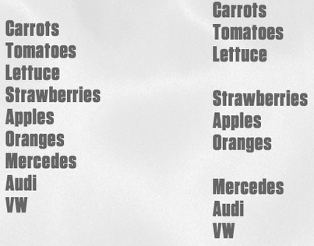
Logical Grouping is possible with white spaces:

Slide 87

physical controls
grouping of items
  defrost settings
  type of food
  time to cook
defrost settings
type of food
time to cook

Slide 88
physical controls
grouping of items
order of items
    type of heating
    temperature
    time to cook
    start
1) type of heating
1
2) temperature
3) time to cook
2
4) start
3
4

Slide 89
physical controls
grouping of items
order of items
decoration
  different colours
  for different functions
  lines around related
  buttons
different colours for different functions
lines around related
buttons (temp up/down)

Slide 90
physical controls
grouping of items
order of items
decoration
alignment
  centered text in buttons
  ? easy to scan ?
centred text in buttons
? easy to scan ?

Slide 91
physical controls
grouping of items
order of items
decoration
alignment
white space
  gaps to aid grouping
gaps to aid grouping

Slide 93
user action and control
entering information
knowing what to do
affordances

Slide 94
entering information
Name:
Alan Dix
Address:
Lancaster
forms, dialogue boxes
  presentation + data input
  similar layout issues
  alignment - N.B. different label lengths
logical layout
  use task analysis (ch15)
  groupings
  natural order for entering information
    top-bottom, left-right (depending on culture)
    set tab order for keyboard entry
✓
Name:
Alan Dix
Address:
Lancaster
?
Name:
Alan Dix
Address:
Lancaster
N.B. see extra slides for widget choice

Slide 95
knowing what to do
what is active what is passive
  where do you click
  where do you type
consistent style helps
  e.g. web underlined links
labels and icons
  standards for common actions
  language – bold = current state or action

Slide 96
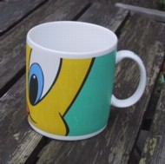
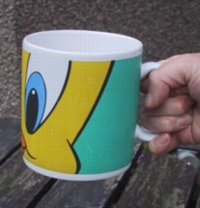
affordances
mug handle
psychological term
for physical objects
  shape and size suggest actions
    pick up, twist, throw
  also cultural – buttons ‘afford’ pushing
for screen objects
  button–like object ‘affords’ mouse click
  physical-like objects suggest use
culture of computer use
  icons ‘afford’ clicking
  or even double clicking … not like real buttons!
‘affords’
grasping

Slide 97
appropriate appearance
presenting information
aesthetics and utility
colour and 3D
localisation & internationalisation

Slide 98
presenting information
purpose matters
  sort order (which column, numeric alphabetic)
  text vs. diagram
  scatter graph vs. histogram
use paper presentation principles!
but add interactivity
  softens design choices
    e.g. re-ordering columns
    ‘dancing histograms’ (chap 21)
name
name
size
size
size
chap1
chap10
chap11
chap12
chap13
chap14
…
chap10
chap5
chap1
chap14
chap20
chap8
…
17
12
51
262
83
22
…
12
16
17
22
27
32
…

Slide 99
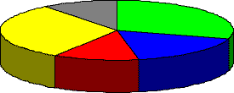
colour and 3D
both often used very badly!
colour
  older monitors limited palette
  colour over used because ‘it is there’
  beware colour blind!
  use sparingly to reinforce other information
3D effects
  good for physical information and some graphs
  but if over used …
  e.g. text in perspective!! 3D pie charts

Slide 100

aesthetics and utility
aesthetically pleasing designs
  increase user satisfaction and improve productivity
beauty and utility may conflict
  mixed up visual styles ⇒ easy to distinguish
  clean design – little differentiation ⇒ confusing
  backgrounds behind text
  … good to look at, but hard to read
but can work together
  e.g. the design of the counter
  in consumer products – key differentiator (e.g. iMac)

Slide 101
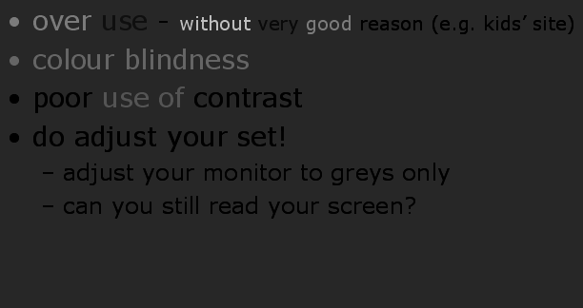
bad use of colour
over use - without very good reason (e.g. kids’ site)
colour blindness
poor use of contrast
do adjust your set!
  adjust your monitor to greys only
  can you still read your screen?

Slide 102
across countries and cultures
localisation & internationalisation
  changing interfaces for particular cultures/languages
  Intersection vs roundabout
globalisation
  try to choose symbols etc. that work everywhere
simply change language?
  use ‘resource’ database instead of literal text
  … but changes sizes, left-right order etc.
deeper issues
  cultural assumptions and values
  meanings of symbols
  e.g tick and cross … +ve and -ve in some cultures
  … but … mean the same thing (mark this) in others
✓
✗

